Slide 1
Krissy Capitano, RN, BSN Michael Ormsbee, PhD October 21, 2020
Navigating ClinicalTrials.gov

Slide 2
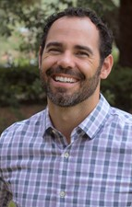
Your Presenters Today
Krissy Capitano, RN, BSN
Clinical Research Navigator
Office for Clinical Research Advancement
Michael J. Ormsbee, PhD
Associate Director
Institute of Sports Sciences & Medicine

Slide 3
Learning Objectives
Understand how new accounts are created on ClinicalTrials.gov for FSU researchers
Be able to determine the types of clinical trials and identify what federal regulations guide clinical trial registration on ClinicalTrials.gov
Become familiarized with the ClinicalTrials.gov PRS Quality Control Review process
Be able to identify study registration timelines and deadline requirements for ClinicalTrials.gov
Be aware of ClinicalTrials.gov resources at FSU and online

Slide 4
Brief Background on ClinicalTrials.gov
1989 –The U.S. AIDS Clinical Trials Information Service first raised public awareness about the value of clinical trials in research, treatment and prevention
2000 – Scandals in publishing selective results to promote efficacy of drugs prompted calls for action
2000 – NIH launched ClinicalTrials.gov to:
increase transparency by making clinical studies and their results publicly available
help prospective study participants identify trials for which they might be eligible
give critically ill people more information about monitored experimental treatments that could save their lives
2008 – ClinicalTrials.gov releases the results database
Notes:
Before ClinicalTrials.gov, there was no standard for reporting adverse events and serious adverse events in clinical trials. An example is Vioxx, a breakthrough drug used to treat Rheumatoid arthritis and had less side effects than other NSAID medications. While this drug had amazing potential for one disorder it increased myocardial infarction and stroke risk in other patient populations. These risks were reported in data to the FDA but never made it out to individual researchers or healthcare providers resulting in deaths and wasted research dollars. The aim of Ct.gov is to improve access to data for not just patients and healthcare providers but for researchers as well.

Slide 5
What studies must be registered on ClinicalTrials.gov?
Notes:
If a clinical trial meets certain criteria it must be registered on ClinicalTrials.gov

Slide 6
NIH Definition of Clinical Trial
NIH-funded study meeting the NIH definition of a clinical trial:
A research study in which one or more human subjects are prospectively assigned to one or more interventions (which may include placebo or other control) to evaluate the effects of those interventions on health-related biomedical or behavioral outcomes.
Notes:
This is for NIH funded clinical trials regardless of the study phase, type of intervention, or whether they are subject to the regulation that became effective January 2017.

Slide 7
NIH Funded Clinical Trials Informed Consent Requirement
Revised Common Rule
Requires NIH-funded clinical trials to post 1 IRB approved version of the IFC used to enroll participants
Posted after recruitment closes
No later than 60 days after last study visit
Notes:
This is a requirement even if the NIH funded trial does not meet the FDAAA definition of ACT.

Slide 8
FDA Definition of Applicable Clinical Trial
Applicable Clinical Trial (ACT)
Interventional
Study site in the U.S./U.S. territory; or subject to an IND or IDE; or involves a drug, biological or device manufactured/exported from U.S./territory for study in another country
Evaluates a drug, biological or device regulated by the FDA
Not a Phase 1 drug/biologic trial and not a device feasibility study
Notes:
The Food and Drug Administration Amendments Acts of 2007 (FDAAA) and the Final Rule require all applicable clinical trials register on ClinicalTrials.gov. Exclusions from the registration and results submission per the FDAAA 801 are phase 1 drug trials, small clinical trials determining feasibility or protype testing, trials that do not include biologics/drugs/devices, non-interventional trials and trials completed by December 2007. Visit ClinicalTrial.gov for a ACT checklist.

Slide 9
ACT Checklist https://prsinfo.clinicaltrials.gov/ACT_Checklist.pdf

Slide 10
Publishing Requirements
International Committee of Medical Journal Editors (ICMJ)
Requires all clinical trials, including Phase 1 ACTs, to be registered as a condition of consideration for publication
A large majority of academic journals that are not members of the ICMJ are following its policy
Notes:
The ICMJ also requires a data sharing statement to be included in study record details.

Slide 11
Diving into the Details Navigating CT.gov
Creating an Account
(New Users)
Contact OCRA
OCRA will create account
ClinicalTrials.gov Administrator will email instructions for completing registration
Organization: FloridaStateU
Review ClinicalTrials.gov PRS User Guide
Creating a new study record
Sponsor: Florida State University
Responsible Party: Principal Investigator
Unique Protocol ID: FSU RAMP IRB Study ID
Notes:
FSU Policy 7A-31 for Clinical Trial Registration, Reporting, and Training delegates the Principal Investigator as the Responsible Party for clinical trial registration on CT.gov. In collaboration with FSU’s Office for Human Subjects Protection in order to increase capabilities for assistance and streamline study registration, the Unique Protocol ID should be the RAMP IRB study ID.

Slide 12
Clinical Trial Registration and Data Element Deadlines
Data Element | Deadline for Registration/Updating
Study Registration | Record must be submitted within 21 days of 1st enrolled participant
Study Start Date | 30 calendar days after 1st subject is enrolled
Primary Completion Date | 30 calendar days after the clinical trial reaches actual primary completion date
Study Completion Date | 30 calendar days after the clinical trial reaches its actual study completion date
Record Verification Date | Due every 12 months while clinical trial is active
Notes:
This list is not all inclusive but highlights the major deadlines. The primary completion date is when the final study participant was examined or received an intervention for the purposes of collecting primary data. The study completion date is the final date in which data was collected. If there are no secondary outcomes, the study completion date would be the same as the primary study completion date.

Slide 13
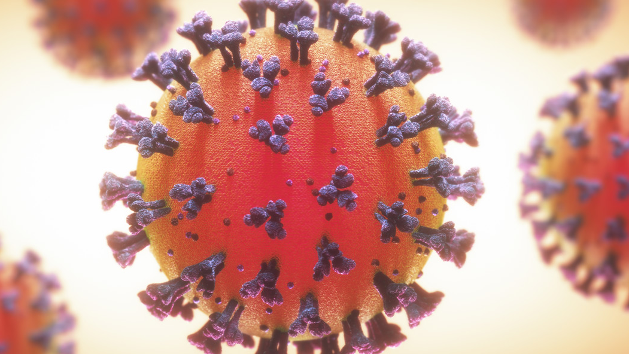
COVID-19 Study Modifications
Researchers that have obtained IRB approval to modify a study in any way that changed communications to clinical trial subjects must also be updated on ClinicalTrials.gov
Update to study record needs to be updated within 30 days after a change in status

Slide 14
Penalties for Not Registering and/or Reporting Results
Applicable Clinical Trials:
Up to $10,000 fine to the Responsible Party
Additional $10,000-per-day fine for continued noncompliance 30 days after notification by CT.gov.
Potential loss of federal funding
Federally funded trials:
Study suspension if a trial’s informed consent is not posted
Potential termination of NIH grants and future grant applications put in jeopardy (PIs and university).

Slide 15
Notes:
Overview of study record submission process. This is tailored to FSU’s process. A study can move back and forth through the process.

Slide 16
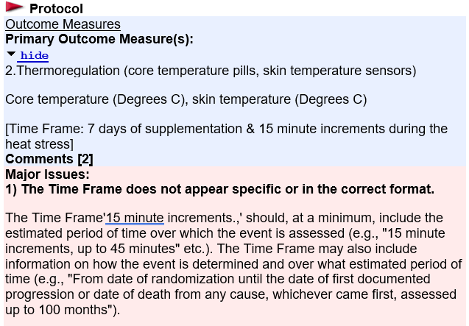
Major Issue Message
These messages must be addressed before the record will be posted on ClinicalTrials.gov

Slide 17
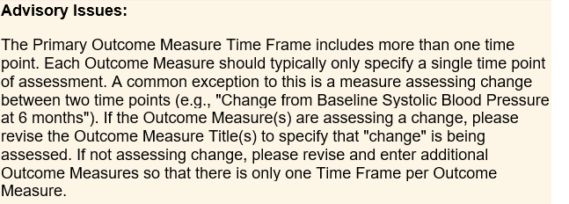
Advisory Messages
Aim to improve the clarity of the record and/or point out best practices
Notes:
Advisory messages are generally attached to major issue messages

Slide 18
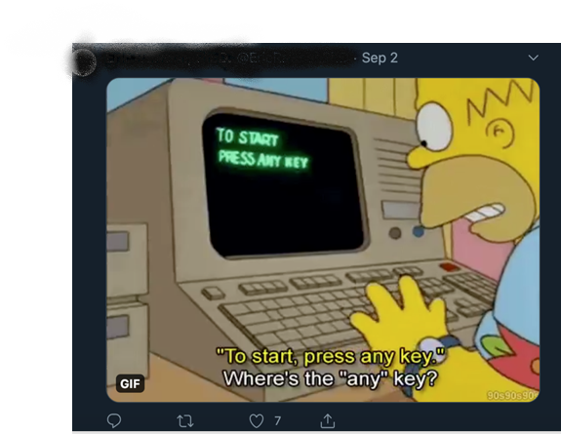
Notes:
Introduce section with FSU ClinicalTrials.gov User Feedback comments:
“the amount of detail needed to get exactly correct to remove all warnings can be challenging for the novice user”
“In general, it is very clunky, hard to navigate and the terminology is not what my field uses so terms overlap and obstruct use”

Slide 19
Twitter Feedback on ClinicalTrials.gov
Notes:
Taking FSU Faculty and Twitter feedback into consideration the next sections will hopefully help address common issues experienced on ClinicalTrials.gov

Slide 20
ClinicalTrials.gov Study Record
NIH Reported
Common Issues
Unclear outcome measures in protocol
Vague timeframes in outcome measures
Multiple timeframes in outcome measures
Missing information from arms/intervention
Notes:
After a study record is submitted, the record will go through a manual quality control review process using an established “review criteria” to identify errors, deficiencies and/or inconsistencies.

Slide 21
Major Issues Outcome Measures
ClinicalTrials.gov definitions
Outcome measure is a planned measurement described in the protocol that is used to determine the effect of an intervention/treatment
Observational study outcome measure is a measurement or observation that is used to describe patterns of disease or traits, or association with exposures, risk factors or treatment
Outcome Measures should include:
Timeframe
Number of participants analyzed
Measure type
Measure of dispersion
Unit of measure

Slide 22
Primary Outcome Measures
Main outcome measurement for evaluating the effect of the intervention/treatment from baseline
A study protocol can have more than one primary outcome measure

Slide 23
Primary Outcome Measure

Slide 24
Secondary Outcome Measures
Secondary outcome measures are used to collect additional effects of the intervention
A study protocol can have more than one secondary outcome measure

Slide 25
Secondary Measure Outcomes

Slide 26
Secondary Measure Outcomes

Slide 27
Major Issues Arms/Interventions
Arm is a group or subgroup of participants in a clinical trial that receives a specific treatment/intervention (role of the intervention)
Experimental arm
Placebo comparator arm
Active comparator arm
Sham comparator arm
No intervention arm
Common issue
Arm or intervention unclear

Slide 28
Arm/Intervention
Arm | Intervention/treatment
Active Comparator: Mineral Rich Algae with orange flavoring. Participants will consume the Aquamin Soluble (Mineral Rich Algae) equivalent of 1000mg Calcium in 250 ml of orange flavored water. Placebo participants will consume a placebo of maltodextrin in 250 ml of orange flavored water (40mg Calcium). | Other Name: Aquamin soluble Dietary Supplement: Mineral Rich Algae Lithothamnion species is rich in calcium, magnesium (Mg) and 72 other trace elements absorbed from sea-water during the organisms life. Mineral-rich 'fronds' break off from the living organism, fall to the ocean floor and are harvested (AquaminF). The mineral extract in soluble form contains ~13.1% Calcium, ~1.04% Magnesium and measurable levels of 72 other trace minerals. Following or prior to a washout period (crossover intervention), participants will consume the Aquamin Soluble equivalent of 1000mg Calcium in 250 ml of orange flavored water for a 7-day loading period. Orange flavored water with maltodextrin as the placebo. Following or prior to a washout period (crossover intervention), participants will consume 250 ml of orange flavored water (containing 20mg of Calcium with maltodextrin) for a 7-day period.

Slide 29
Arm/Intervention

Slide 30
PRS Email Notice of Study Becoming Public Record

Slide 31
Clinical trial is done! What’s next?
FDAAA 801
Mandates submission of results data for certain clinical trials of biologics, drugs, and devices to ClinicalTrials.gov
Still required to report even if results are not published
Data Results require posting:
Participant Flow
Baseline Characteristics
Outcome Measures and Statistical Analysis
Adverse Events
Notes:
If your clinical trial meets this criteria, there are templates for participant flow, baseline characteristic, outcome measures and statistical analysis, and adverse events on ClinicalTrials.gov.

Slide 33
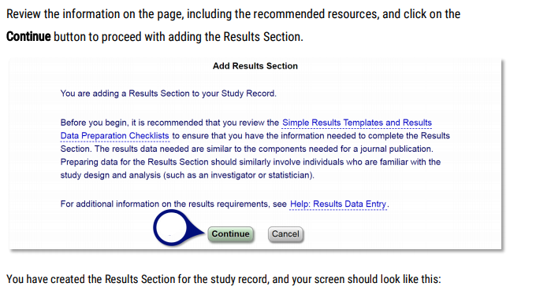
1
2
Notes:
To enter data result you will have to login to CT.gov, locate the study record and on the Record Summary page click “Enter Results” hyperlink

Slide 34
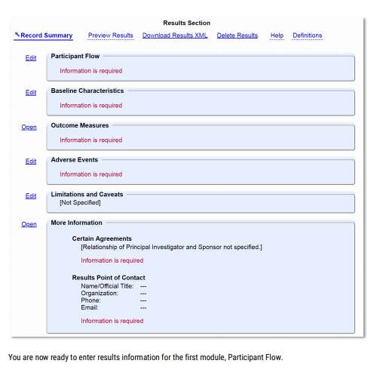
Entering Data Results

Slide 35
Resources Available
ClinicalTrials.gov Resource
PRS Information, Users Guide and Tutorials
https://prsinfo.clinicaltrials.gov/
Other ClinicalTrials.gov Resources
ClinicalTrials.gov What’s New?
https://clinicaltrials.gov/ct2/about-site/new
Hot off the PRS! Sign up here: https://public.govdelivery.com/accounts/USNLMOCPL/subscriber/new?topic_id=USNLMOCPL_30
FSU Resources
OCRA ClinicalTrials.gov Guidance
https://ocra.fsu.edu/clinical-trial-assistance/clinicaltrialsgov-guidance/

Slide 36
Thank you! Questions & Answers

